Slide 1
YETI COOLERS: A FIELD GUIDE TO ANALYTICS
SAM SANTOS
WENBIN ZHAO
DATA VISUALIZATION ARCHITECT
BUSINESS ANALYTICS DEVELOPER
YETI
YETI
#data19
Notes:
Lot more about ourselves, who we are and where we come from.
“We can tell you how to your beer cold for hours, but today we’re going to talk about big data and geo-analytics.”
From Colorado, grew up in the outdoors and in the mountains and love working at a company like YETI that promotes the outdoors so much.

Slide 2

Notes:
Introductions to ourselves and YETI.
Seider’s bros. background
Talking about the “cult” brand. Why is it a cult and how does it bring people in.
What YETI does and why

Slide 3
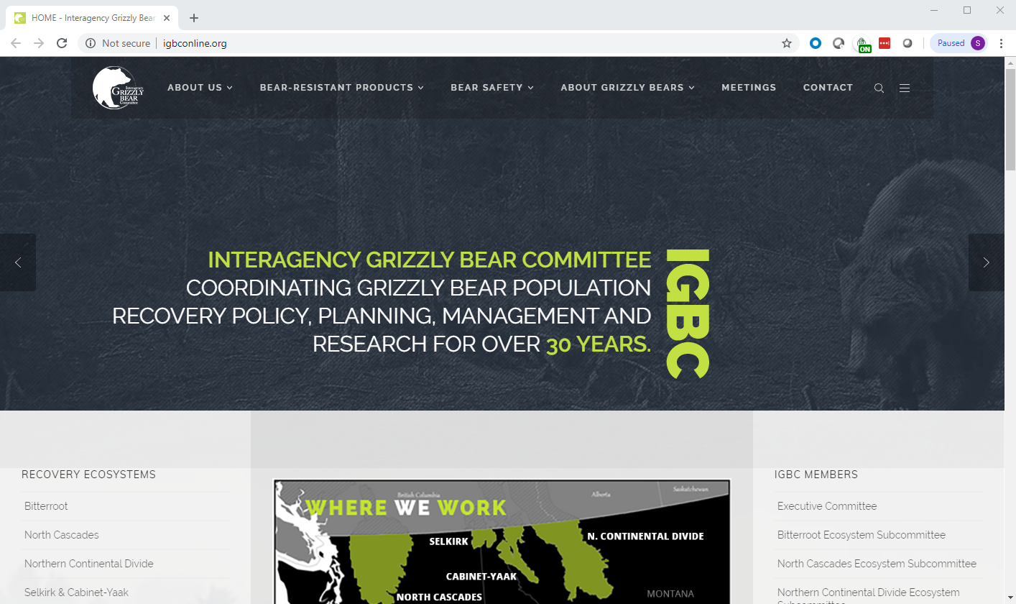


ARE THEY REALLY BEAR PROOF?
http://igbconline.org/
Notes:
How we filled in the gaps of our data.
Talk about 80/20 rule. Even if not 100% of the data is clean, we can still derive valuable insights.

Slide 4

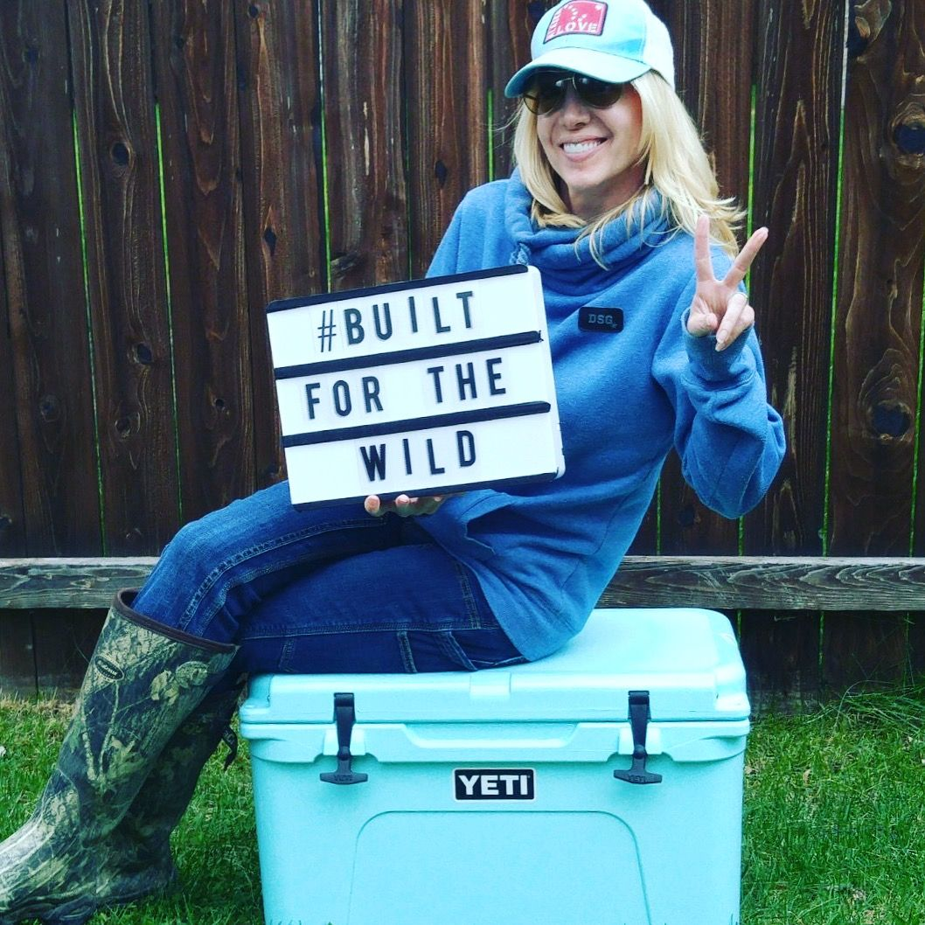
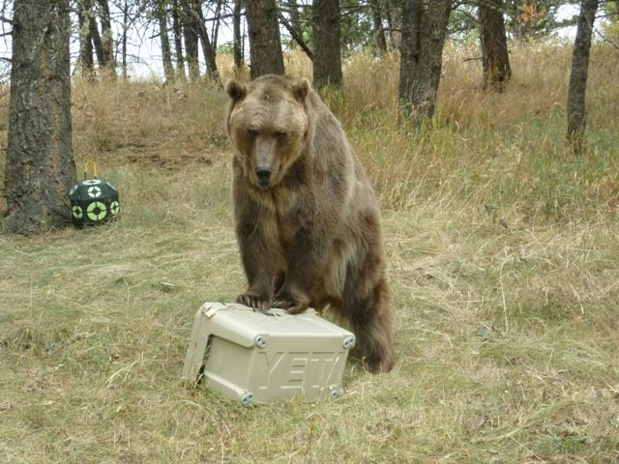
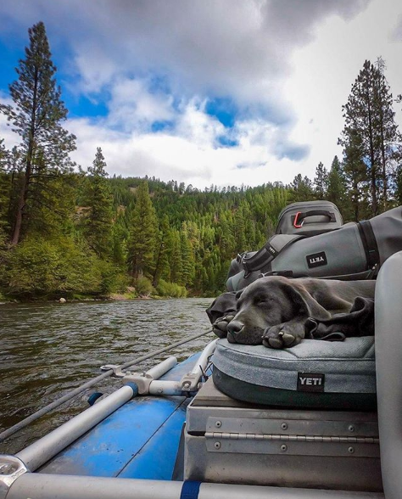

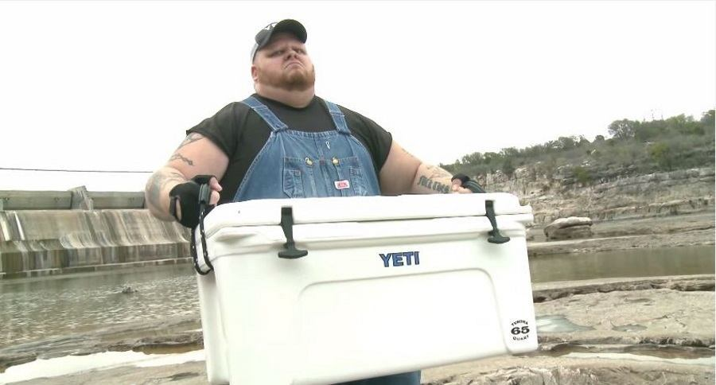



Slide 5
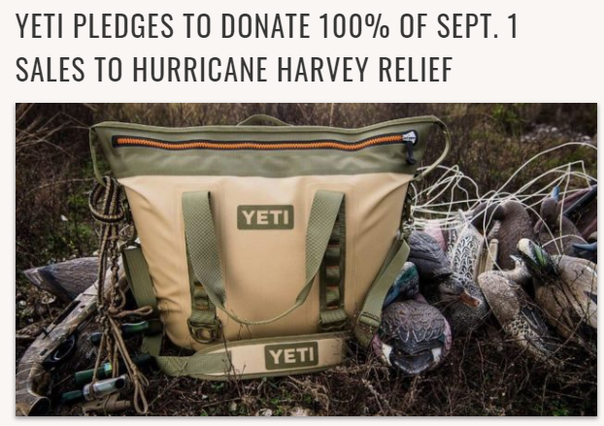
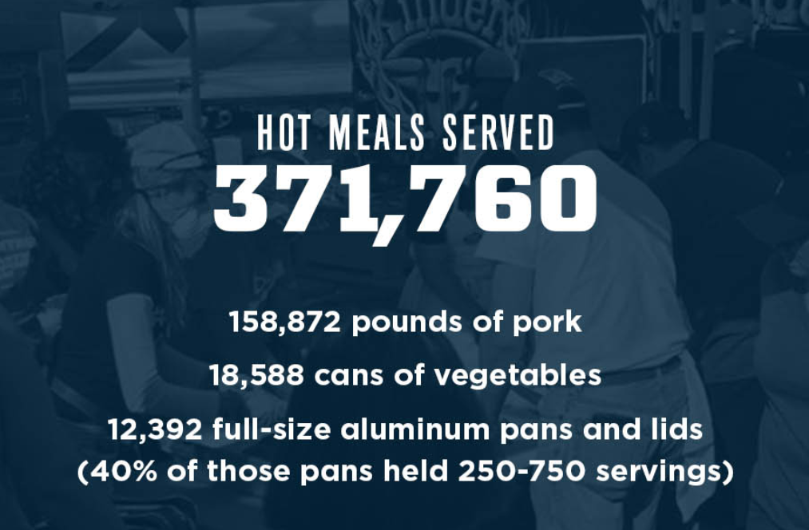
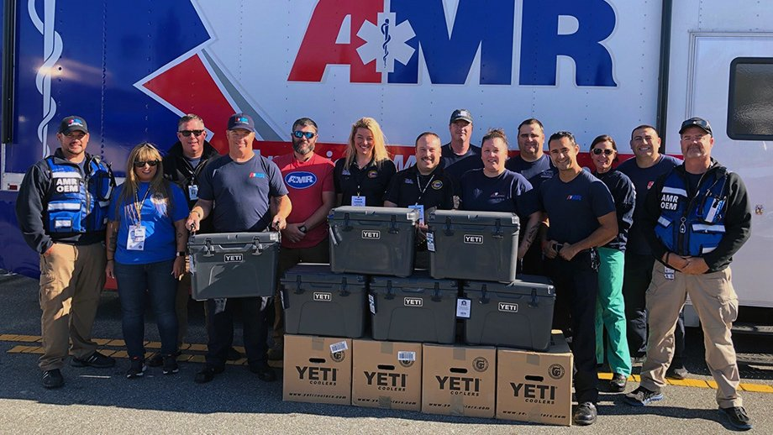

YETI COMMUNITY OF GIVING
OPERATION BBQ RELIEF
HURRICANE MICHAEL

Slide 6
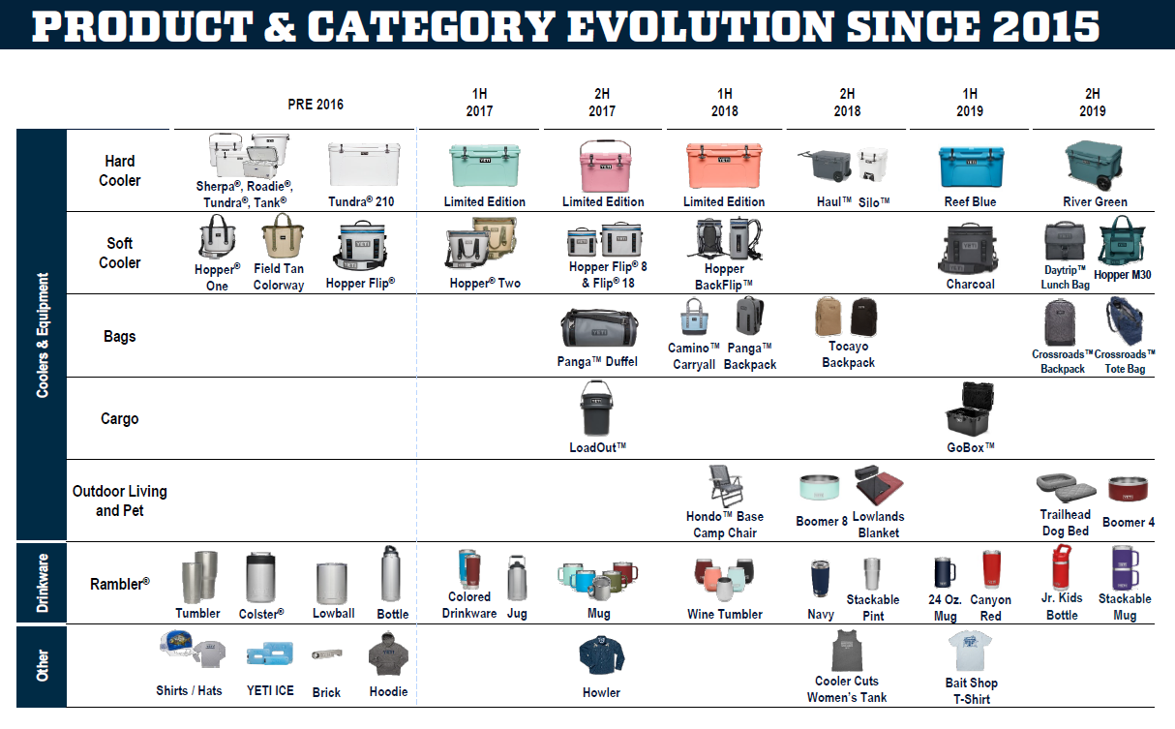

Slide 7

YETI & TABLEAU
Notes:
who our team is and how we started

Slide 8


ANALYTICS FOUNDATION
WHAT IS GOING TO HAPPEN
WHAT IS HAPPENING
WHAT HAS HAPPENED
Notes:
Flip Text, boxes on right.
At YETI our goal is to predict the future, that’s everyone's goal.
When we started, realized needed a foundation
Knowing What Has Happened leads to
Knowing What’s Happening now which leads to
Knowing What’s Going to Happen.
Through this framework we had the question of “How do our sales channels compare geographically”
We have 3 main sales channels, DTC (Amazon and YETI.com), Wholesale, and our own Retail stores.
Each of these sales are tracked and maintained in different systems and so the relationships between them were unknown.
This is how we

Slide 9

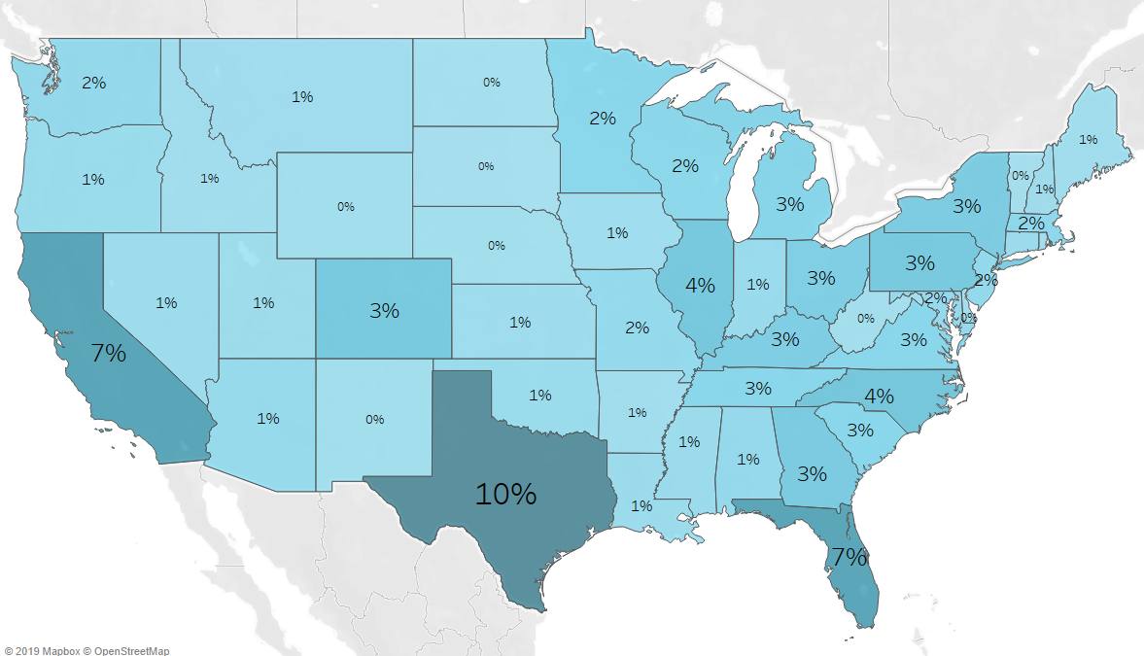
SAMPLED CUSTOMER
DISTRIBUTION FOR E-COMM
Notes:
A look at our % of sales across the country

Slide 10
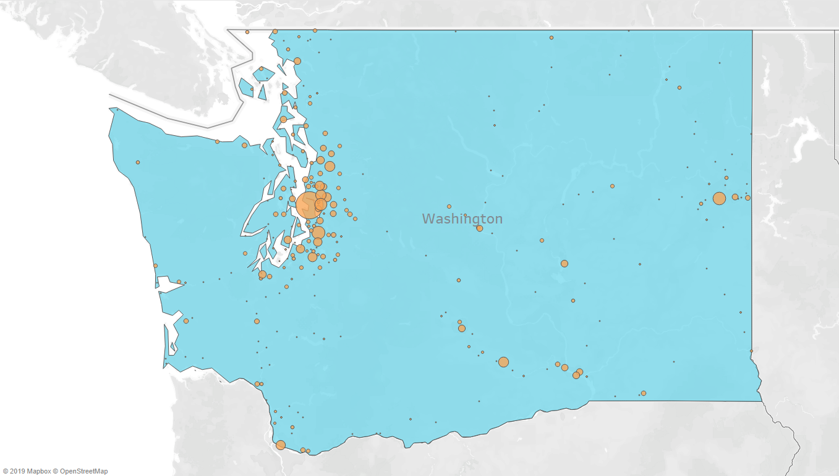
SAMPLED CUSTOMER
DISTRIBUTION FOR E-COMM
Notes:
A look at our % of sales across the country

Slide 11
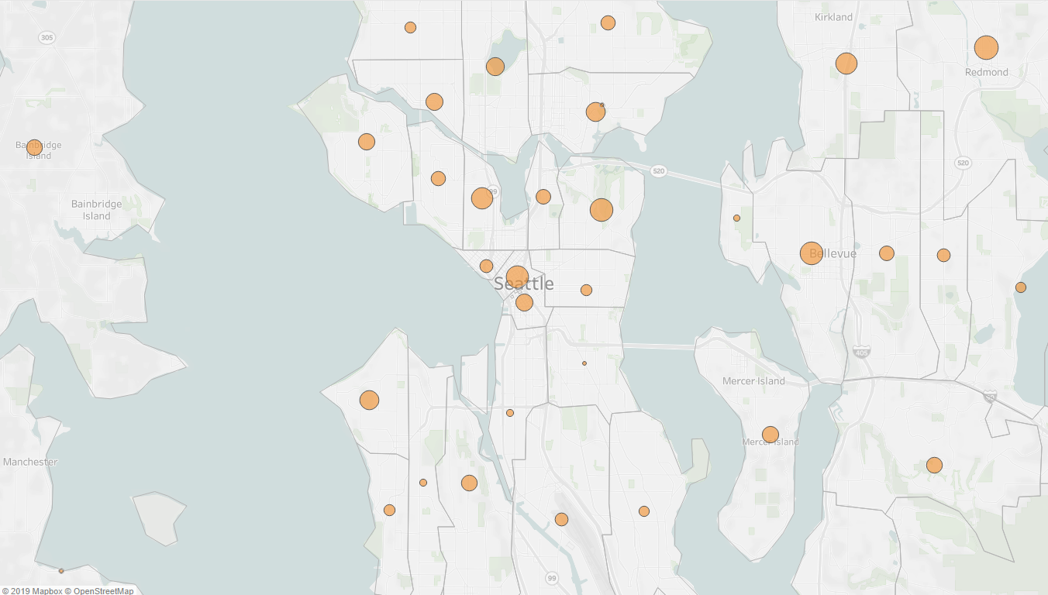
SAMPLED CUSTOMER
DISTRIBUTION FOR E-COMM
Notes:
A look at our % of sales across the country

Slide 12
DATA BLENDING
Source | Order Date | Product ID | Customer ID | ZIP
E-Comm | Available | Available | Available | Available
E-Comm Custom | Available | Unavailable | Available | Available
3rd Party E-Comm | Available | Unavailable | Available | Available
YETI Retail | Available | Available | Unavailable | Available
3rd Party Retail | Unavailable | Unavailable | Unavailable | Partial
Notes:
How we filled in the gaps of our data.
Talk about 80/20 rule. Even if not 100% of the data is clean, we can still derive valuable insights.

Slide 13
DATA BLENDING
Source | Order Date | Product ID | Customer ID | ZIP
E-Comm | Available | Available | Available | Available
E-Comm Custom | Available | Custom Hierarchy | Available | Available
3rd Party E-Comm | Available | Custom Mapping | Available | Available
YETI Retail | Available | Available | Use Distinct Codes | Available
3rd Party Retail | Purchase Date | Custom Hierarchy | Use Distinct Codes | Use Account Billing
Notes:
How we filled in the gaps of our data.
Talk about 80/20 rule. Even if not 100% of the data is clean, we can still derive valuable insights.

Slide 14

SAMPLED CUSTOMER
DISTRIBUTION FOR E-COMM
Notes:
A look at our % of sales across the country

Slide 15
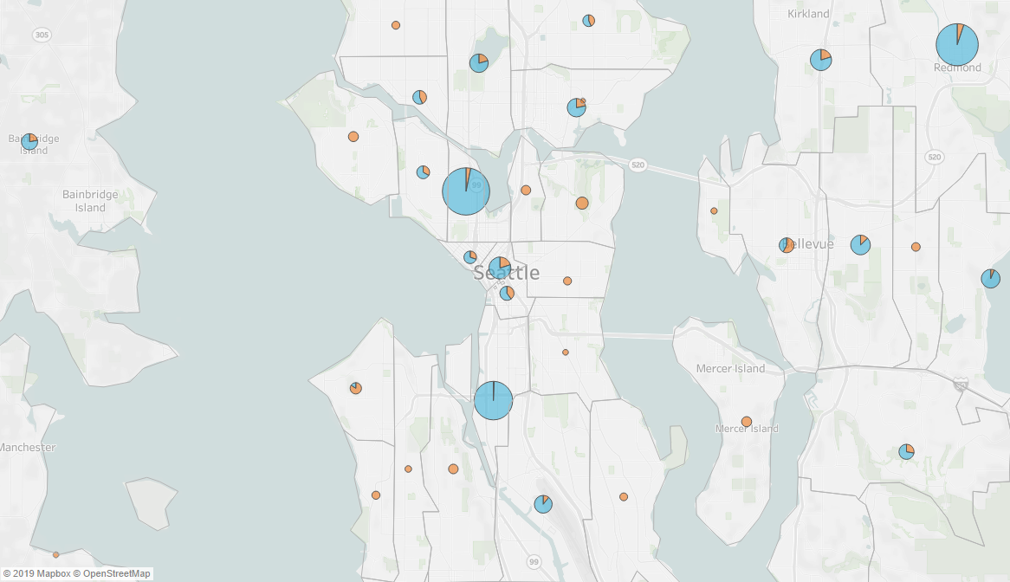
= E COMM
= RETAIL
REI
REI
OUTDOOR EMPORIUM
SAMPLED CUSTOMER
DISTRIBUTION FOR E-COMM AND RETAIL
Notes:
A look at our % of sales across the country

Slide 16
DATA SORTING
Source | Order ID | Address | City, ZIP | Geo Lat. / Long.
E-Comm | Available | Available | Available | Unavailable
E-Comm Custom | Available | Available | Available | Unavailable
3rd Party E-Comm | Available | Partial | Available | Unavailable
YETI Retail | Unavailable | Available | Available | Unavailable
3rd Party Retail | Partial | Partial | Partial | Unavailable
Notes:
How we filled in the gaps of our data.
Talk about 80/20 rule. Even if not 100% of the data is clean, we can still derive valuable insights.

Slide 17
DATA SORTING
Source | Order ID | Address | City, ZIP | Geo Lat. / Long.
E-Comm | Available | Available | Available | Unavailable
E-Comm Custom | Available | Available | Available | Unavailable
3rd Party E-Comm | Available | Follow up w/ supplier | Available | Unavailable
YETI Retail | Use Purchase ID | Available | Available | Unavailable
3rd Party Retail | Use Purchase ID | Use Account Billing | Use Account Billing | Unavailable
Notes:
How we filled in the gaps of our data.
Talk about 80/20 rule. Even if not 100% of the data is clean, we can still derive valuable insights.

Slide 18

GOOGLE MAP SAVES THE DAY
ETL
Return
API
Notes:
- Persist addresses to Bigquery geocode.address_to_geocode table
- Publish addresses to geocode through ETL Job (Data cloud dataflow scheduled with Composer)
- Request geography data from Google Geocoding API for geocode-request per row
Publish Geocoding API response back to matching address row
Google Maps API will throttle automatically and helps prevent passing quota
Load Google Cloud Storage to Bigquery geocode.address_geocode table
76K records in 10 min w/ 60 nodes

Slide 19
DATA SORTING
Source | Order ID | Address | City, ZIP | Geo Lat. / Long.
E-Comm | Available | Available | Available | Google API Lookup
E-Comm Custom | Available | Available | Available | Google API Lookup
3rd Party E-Comm | Available | Follow up w/ supplier | Available | Use ZIP Lat. / Long.
YETI Retail | Use Purchase ID | Available | Available | Google API Lookup
3rd Party Retail | Use Purchase ID | Use Account Billing | Use Account Billing | Google API Lookup
Notes:
How we filled in the gaps of our data.
Talk about 80/20 rule. Even if not 100% of the data is clean, we can still derive valuable insights.

Slide 20

= E COMM
= RETAIL
SAMPLED CUSTOMER
DISTRIBUTION FOR E-COMM AND RETAIL
Notes:
A look at our % of sales across the country

Slide 21
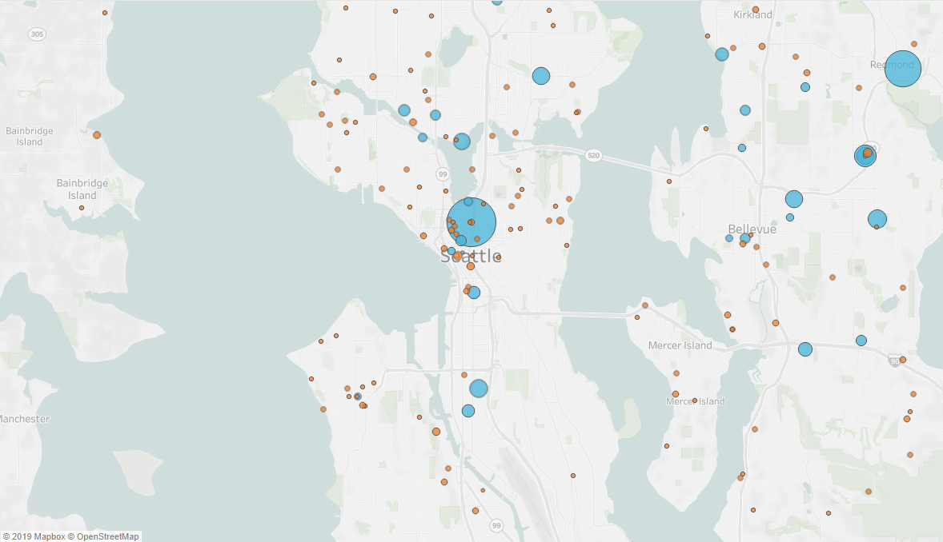
= E COMM
= RETAIL
SAMPLED CUSTOMER
DISTRIBUTION FOR E-COMM AND RETAIL
Notes:
A look at our % of sales across the country

Slide 22
= E COMM
= RETAIL
SAMPLED CUSTOMER
DISTRIBUTION FOR E-COMM AND RETAIL
Notes:
A look at our % of sales across the country

Slide 23
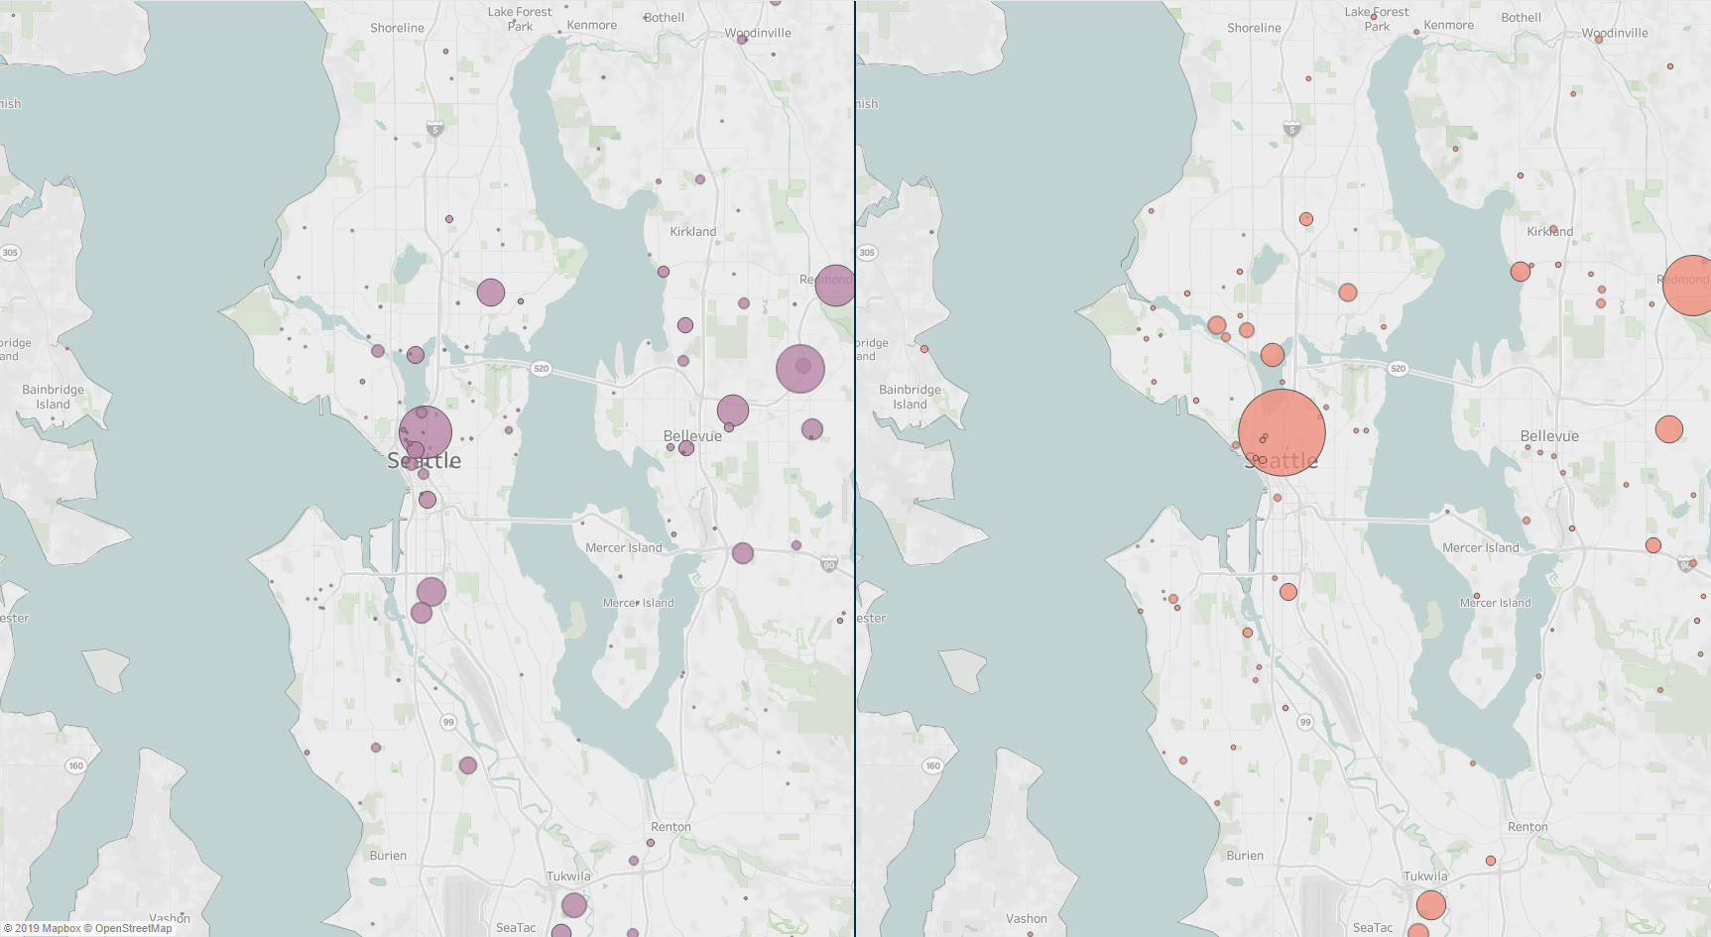
DRINKWARE
ALL CHANNELS
OUTDOOR EQUIPMENT
ALL CHANNELS
SAMPLED CUSTOMER
DISTRIBUTION FOR E-COMM AND RETAIL
Notes:
A look at our % of sales across the country

Slide 24
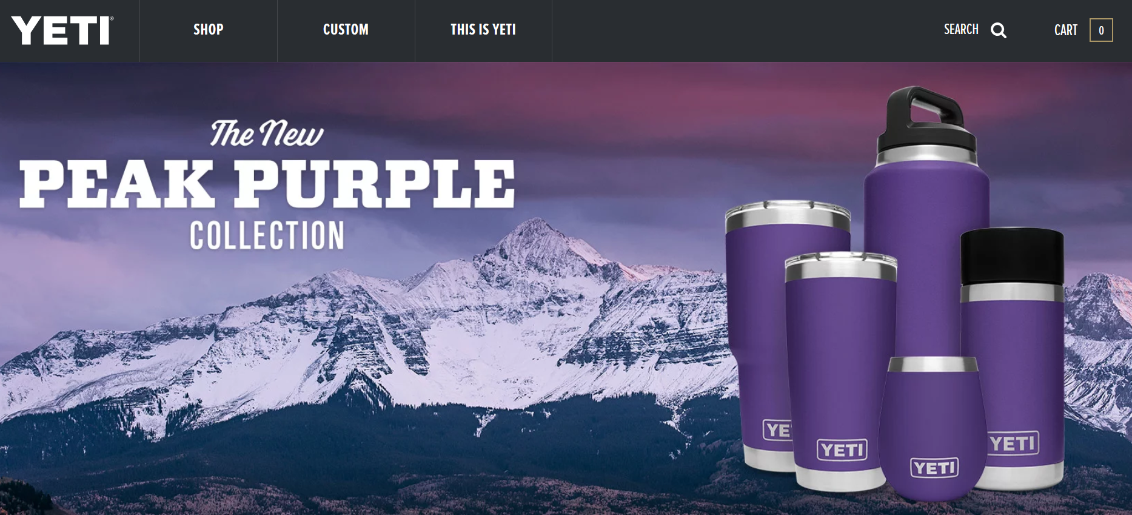
PEAK PURPLE: A CASE STUDY
NEW POPULAR COLOR
PERFORMANCE TRACKING

Slide 25
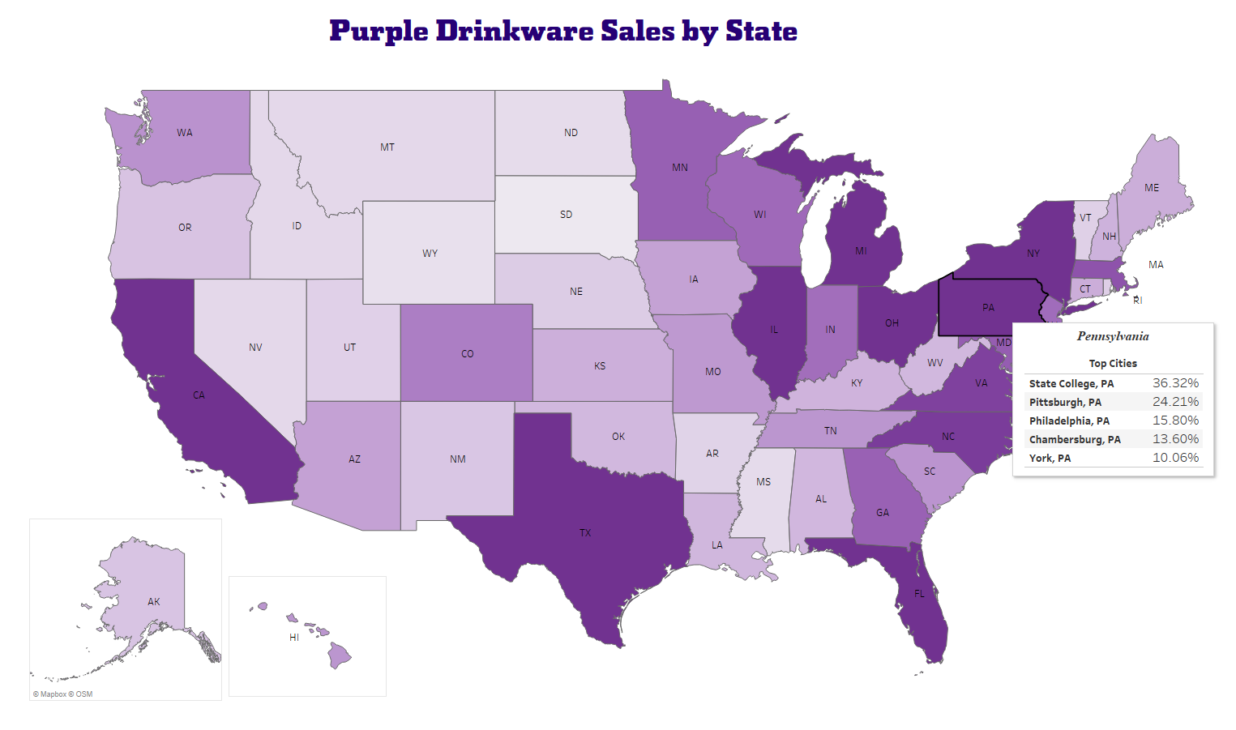
DIAGNOSTIC ANALYSIS
INTERESTING INSIGHTS LEADS TO OPPORTUNITIES

Slide 26

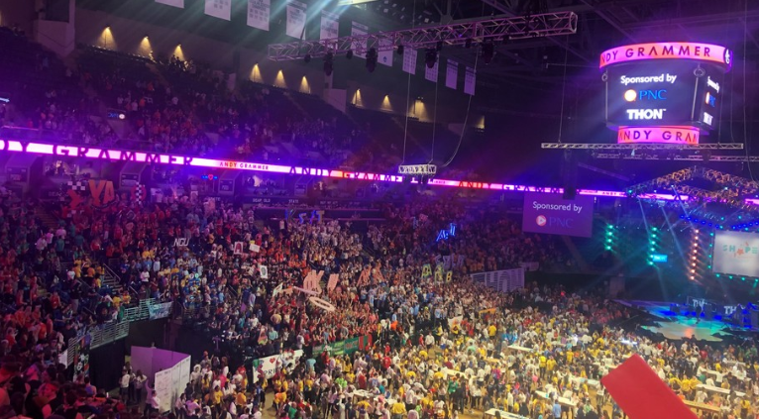

MAKING A DIFFERENCE
https://thon.org/

Slide 27
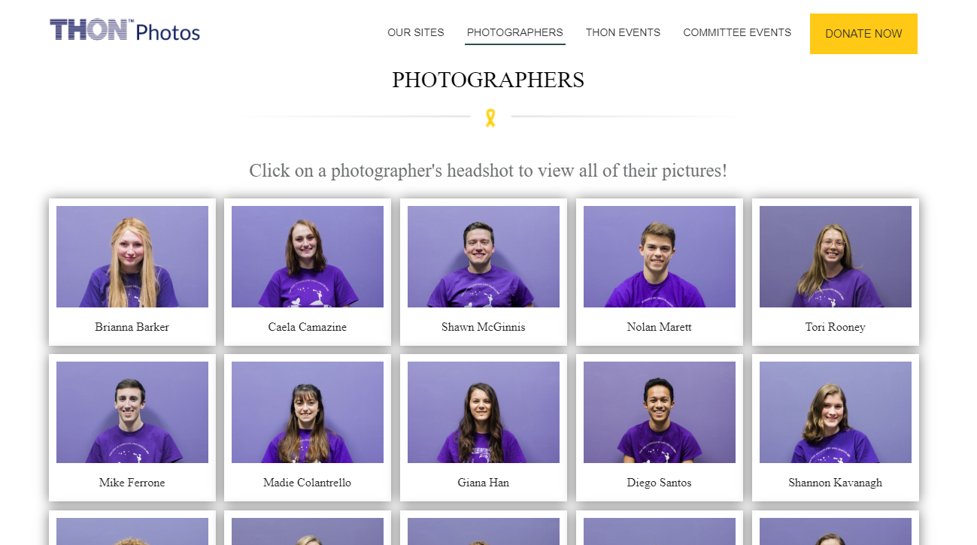
https://thon.org/

Slide 28
TODAY
DATA-DRIVEN MARKETING DECISIONS
SALES CHANNEL AT A GLANCE
IDENTIFY NEW MARKETING OPPORTUNITIES
TARGET NEW AUDIENCES WITH PRECISION

Slide 29
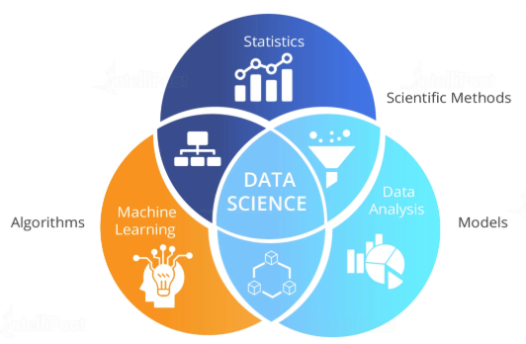
NEXT
AGILE DATAWAREHOUSE
ADVANCED ALGORITHMS AND DATA SCIENCE MODELS
FROM CUSTOMER INSIGHTS TO PREDICTIVE ANALYSIS
TABLEAU’S ROLE IN DEVELOPING DATA CULTURE AND DATA-DRIVEN BI

Slide 30

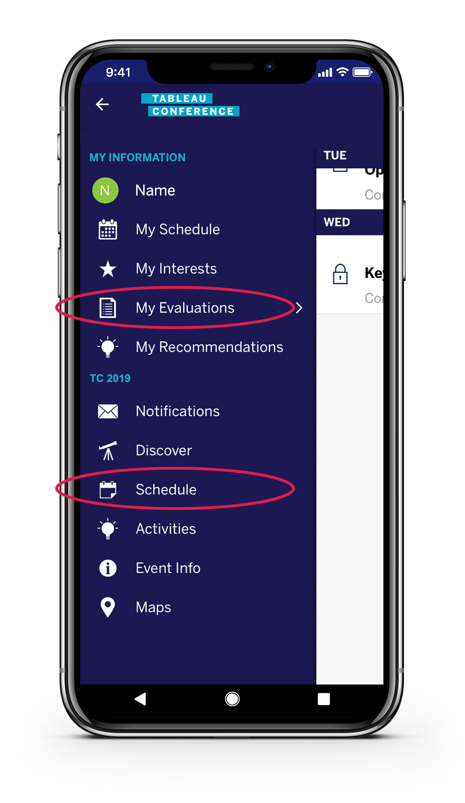
THANK YOU
PLEASE COMPLETE THE SESSION SURVEY IN THE MOBILE APP
VIEW ‘MY EVALUATIONS’ IN THE MENU OR FIND THE SESSION UNDER ‘SCHEDULE’
Notes:
A look at our % of sales across the country

